Slide 1
Chapter 3
Where Prices Come From: The Interaction of Demand and Supply
Notes:
Welcome to Economics!
Does this work?

Slide 2
In the model of demand and supply, we assume that the market is competitive in the sense that:
The product or service is homogeneous (“the same”).
No individual buyer or seller can affect the prevailing market price.
There is free entry and exit of buyers and sellers into and out of the market.
We look first at demand, then at supply, then at equilibrium, and finally we examine the effects of changes in supply and demand.

Slide 3
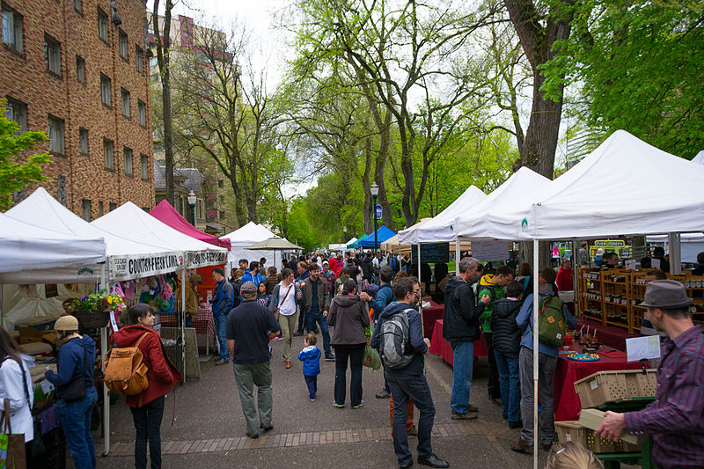
Competitive Market: Lots of small buyers and sellers

Slide 4
The Demand Side of the Market
We use demand schedules (numerical tables) and demand curves (graphs) to show the relationship between the price of a product and the quantity demanded of that product.
This relationship is termed the “law of demand”. The law of demand says that, ceteris paribus, as the price of a good increases, the quantity demanded of the good
Note the quantity demanded is the amount of a good or service that a consumer is ____________ and _________ to purchase at a given price.

Slide 5

Price of Ice-Cream Cone | Quantity of Cones Demanded
$0.50 | 1200
$1.00 | 1000
$1.50 | 800
$2.00 | 600
$2.50 | 400
$3.00 | 200
Price per Cone ($)
Quantity of Cones

Slide 6
Demand curves can be read in two ways:
Horizontally: How much buyers are willing and able to purchase at a certain price.
Vertically: The highest price buyers are willing to pay for a certain quantity.
The height of the demand curve represents the “Marginal willingness to pay” for that unit of the good, which is the same thing as the marginal _____________ which that consumer expects to get from consuming that unit of the good.

Slide 7


Demand Curve and “willingness to pay”
When the price is high, oil will only be used in the high value products. If the price falls, oil will also be used in lower value products.
Price of Oil per Barrel
Higher Valued Uses of Oil
$120
Lower Valued Uses of Oil
$20
Demand
Quantity of Oil (MBD)
20
120

Slide 8
Changes in quantity demanded are movements along a demand curve and are caused by changes in the price of the good itself
Changes in demand are shifts of the demand curve and are caused by changes in “non-price” determinants of demand
Price
D₁
Quantity

Slide 9


Slide 10
An Increase in Demand
Price per Barrel
Greater Willingness to Pay for the Same Quantity
$110
Greater Quantity Demanded at the Same Price
$80
New Demand Curve
Old Demand Curve
60
100
Q of Oil
(MBD)

Slide 11
A Decrease in Demand
Price per Barrel
Lower Willingness to Pay for the Same Quantity
$120
Less Quantity Demanded at the Same Price
$80
Old Demand Curve
New Demand Curve
Q of Oil
(MBD)
20
40

Slide 12
Variables that shift market demand
Income
Normal Good: A good whose demand curve shifts to the right as the incomes of buyers
Inferior Good: A good whose demand curve shifts to the right as the incomes of buyers

Slide 13
The prices of related goods
Substitutes (in consumption): When the price of a good increases, the demand for its substitute will
Beef
Chicken
Price
Price
D
D
Quantity
Quantity

Slide 14


Slide 15


Slide 16
The prices of related goods
Complements (in consumption): When the price of a good increases, the demand for its complement will
Hot Dogs
Hot Dog Buns
Price
Price
D
D
Quantity
Quantity

Slide 17
Tastes and Preferences
Population and demographics
As the number of potential buyers increases, the demand for that good
Expected future prices
If consumers expect the price of a good to increase in the future, then their current demand for the good will

Slide 18
The Supply Side of the Market
We use supply schedules (numerical tables) and supply curves (graphs) to show the relationship between the price of a product and the quantity supplied of that product.
This relationship is termed the “law of supply”. The law of supply says that, ceteris paribus, as the price of a good increases, the quantity supplied of the good
Note the quantity supplied is the amount of a good or service firms are ____________ and _________ to supply at a given price.

Slide 19
Price of Ice-Cream Cone | Quantity of Cones Supplied
$0.50 | 0
$1.00 | 100
$1.50 | 200
$2.00 | 300
$2.50 | 400
$3.00 | 500
Price per Cone ($)
Quantity of Cones

Slide 20
Supply curves can be read in two ways:
Horizontally: How much sellers are willing and able to sell at a certain price.
Vertically: The minimum price for which sellers are willing to sell a certain quantity.
The height of the supply curve represents the
“Marginal cost” of producing that unit of the good.

Slide 21


At a low price, a good is produced and sold only by the lowest cost suppliers. At a high price, a good is also produced and sold by higher cost suppliers.
Price of Oil per Barrel
The Supply Curve for Oil
Supply
$120
Oil Shale Profitable Here
$80
Higher Cost Oil
Low Cost Oil
$40
Quantity of Oil (MBD)
20
40
60
80
100
Notes:
The Supply Curve for Oil As the price of oil rises, it becomes profitable to extract oil from more costly sources. Thus, as the price of oil rises the quantity of oil supplied increases.
Low Cost Oil: Saudi Arabia
High Cost Oil: Oil Shale
Low cost oil producers in Saudi Arabia are willing to sell their oil at low prices while high cost U.S. oil producers require a higher price to sell their oil.

Slide 22
Changes in quantity supplied are movements along a supply curve and are caused by changes in the price of the good itself
Changes in supply are shifts of the supply curve and are caused by changes in “non-price” determinants of supply
Price
S₁
Quantity

Slide 23
An Increase in Supply
Price of Oil per Barrel
Greater Quantity Supplied at the Same Price
Old Supply
New Supply
$100
$70
Willing to Sell Same Quantity at Lower Prices
Quantity of Oil (MBD)
20
80
Notes:
Instructor Notes: Figure 2.11: Shifting the Supply Curve (A) A decrease in costs shifts the supply curve down and to the right.

Slide 24
A decrease in Supply
New Supply
Price of Oil per Barrel
Old Supply
Smaller Quantity Supplied at the Same Price
$100
Higher Price Needed to Sell Same Quantity
Quantity of Oil (MBD)
20
80
Notes:
Instructor Notes: Figure 2.11: Shifting the Supply Curve (A) A decrease in costs shifts the supply curve down and to the right.

Slide 25
Variables that shift market supply
Prices of inputs
As the prices of inputs to the production of the good increase, there will be a __________________ in the supply of that good
Technological Change
If a technological advance lowers the cost of production of a good, there will be __________________________ in the supply of that good

Slide 26
The prices of “substitutes in production”
E.g. Tillamook Dairy could use the same basic inputs to produce ice cream, cheese, yogurt, and sour cream. These are substitutes in production.
When the price of a good increases, then the supply of its substitute in production ________________ .
Yogurt
Sour Cream
Price
Price
S
S
Quantity
Quantity

Slide 27
Number of firms
When the number of firms in a market increases, then the supply of the good
Expected Future Prices
When a firm expects the price of product to rise in the future, it has an incentive to

Slide 28
Market Equilibrium
Put market supply and market demand together to get market equilibrium.
Market Equilibrium is a situation, described by a combination of price and quantity traded, in which
Graphically, it occurs where the market supply curve and the market demand curve

Slide 29
Price per Cone | Q_{S} of Cones | Q_{d} of Cones
$0.50 | 0 | 1200
$1.00 | 100 | 1000
$1.50 | 200 | 800
$2.00 | 300 | 600
$2.50 | 400 | 400
$3.00 | 500 | 200
Price
Supply
Demand
Quantity

Slide 30
If a market is not in equilibrium, it will tend to move toward equilibrium.
If the price is below equilibrium price, there is a
There is thus pressure upward on prices. As prices rise, the shortage is alleviated in 2 ways:
↑ Price causes both
If the price is above equilibrium price, there is a
There is thus downward pressure on prices, which causes

Slide 31
Demand and Supply Both Count
Always keep in mind that it is the interaction of demand and supply that determines the equilibrium price.
Neither consumers nor firms can dictate what the equilibrium price will be.
No firm can sell anything at any price unless it can find
and no consumer can buy anything at any price without finding
Trade is a voluntary act that requires cooperation between buyers and sellers.

Slide 32
Price
Quantity

Slide 33
Once a market reaches equilibrium, it will remain in equilibrium until one of the underlying conditions changes.
When demand, supply, or both shift, the resulting equilibrium price and quantity will change. (You should understand the effects on market equilibrium of all possible shifts in supply and/or demand.)
Single Shifts: When either supply or demand changes, we will know with certainty the direction of the changes in
Simultaneous Shifts: When both supply and demand shift, the effect on one variable (either price or quantity) will be unambiguous, while the effect on the other variable (either price or quantity) will be ambiguous. The direction on the ambiguous effect depends upon

Slide 34
Application 1
Price
S₁
P₁
D₁
Q₁
Quantity

Slide 35
Application 2
Price
S₁
P₁
D₁
Q₁
Quantity

Slide 36
Application 3
Price
S₁
P₁
D₁
Q₁
Quantity

Slide 37
Application 4
Price
S₁
P₁
D₁
Q₁
Quantity

Slide 38
Application 5
Price
S₁
P₁
D₁
Q₁
Quantity

Slide 39
Application 6
Price
S₁
P₁
D₁
Q₁
Quantity

Slide 40
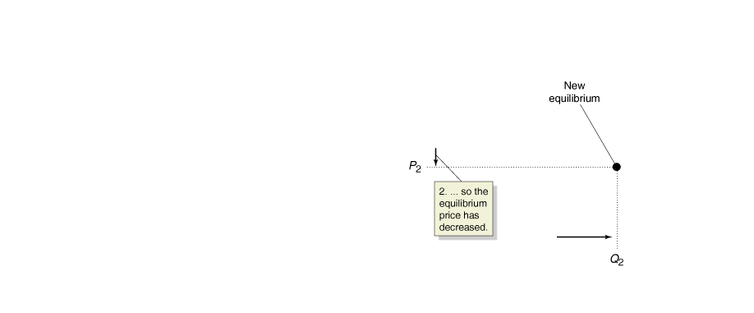
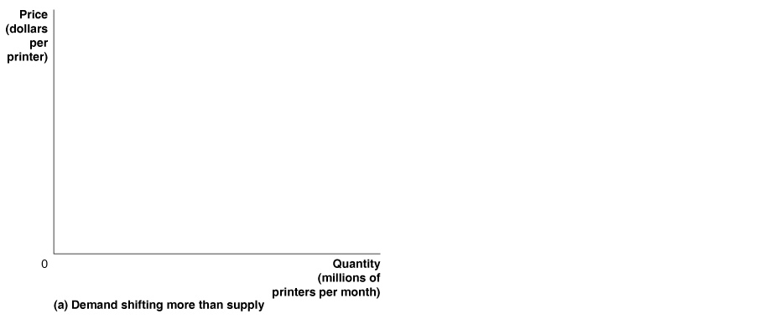
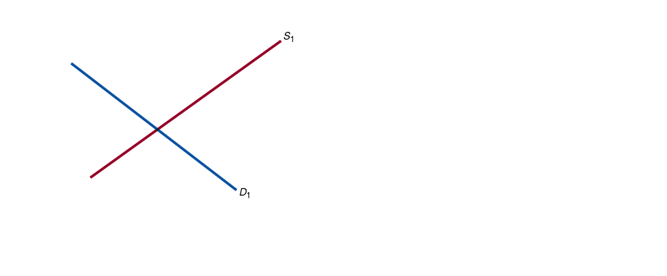
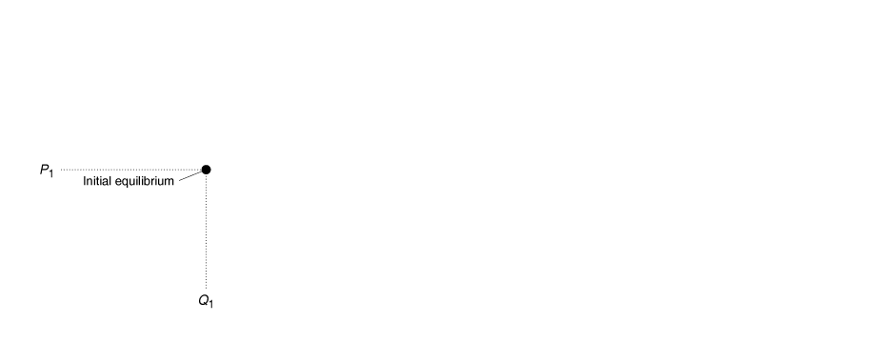
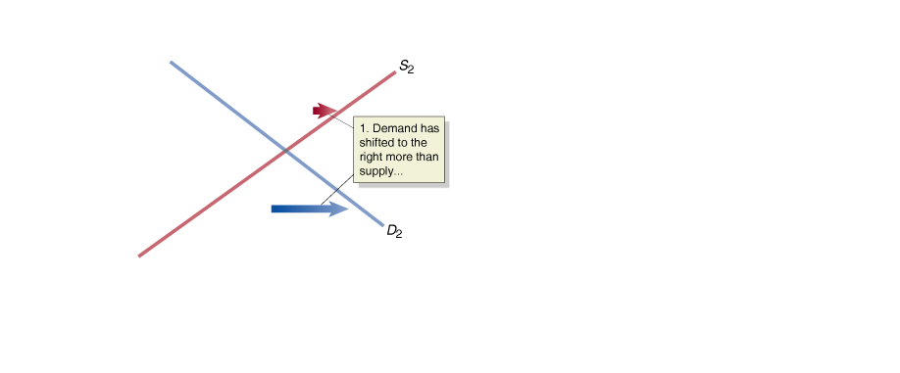
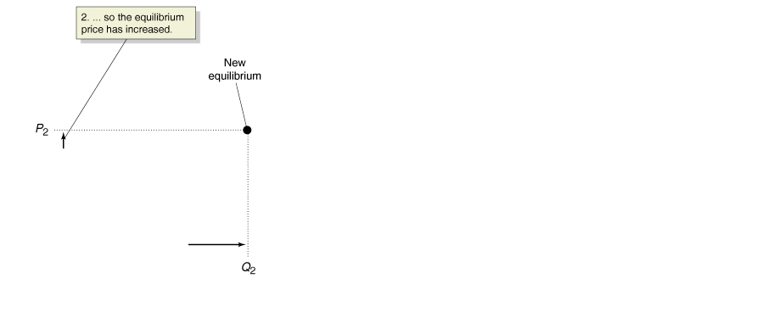
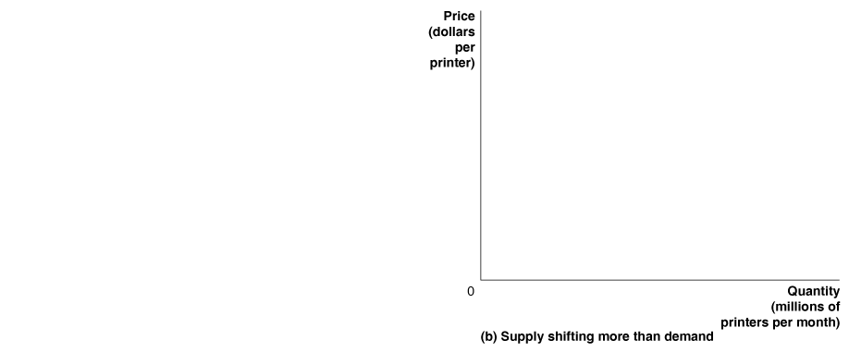
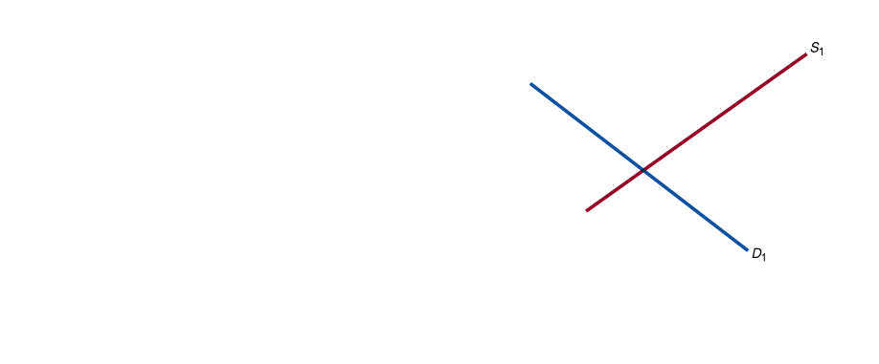
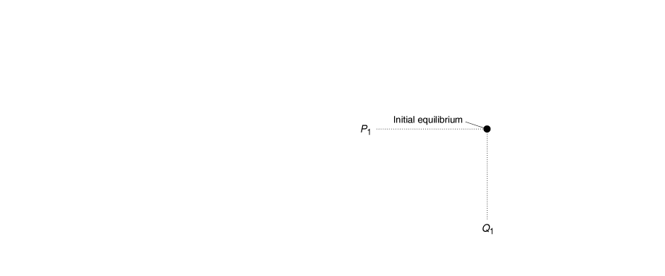
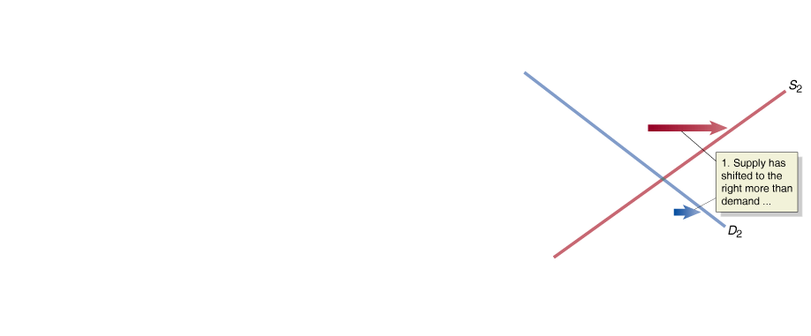
The Effect of Shifts in Demand and Supply over Time
For many goods, both supply and demand increase over time. What does this do to the equilibrium quantity and the equilibrium price?

Slide 41
Application: Tomatoes are input to salsa production. Also assume that salsa and guacamole are consumption substitutes. Suppose a freeze destroys part of the tomato crop. What are the equilibrium effects on the tomato, salsa, and guacamole markets?
Tomatoes
Salsa
Guacamole
P
P
P
S
S
S
P₁
P₁
P₁
D
D
D
Q₁
Q
Q₁
Q
Q₁
Q

